Slide 1
Dynamic Graph Algorithm on Strongly Connected Components in CUDA
Sai Siddarth
cs20b059

Slide 2
Contents:
Problem Statement
Split and Condense of Graph G
SCC Tree Creation
SCC Incremental Algorithm
Reachability
SCC Decremental Algorithm
Results
Challenges Faced

Slide 3
Problem Statement:
This problem focuses on efficiently managing dynamic graphs, particularly in maintaining Strongly Connected Components (SCCs) trees as edges are added or removed. With graphs growing larger and more complex, traditional methods of recomputing SCCs from scratch are impractical.
The challenge is to develop algorithms that selectively update SCC trees, reducing the time and computational resources needed for managing dynamic graphs. Key obstacles include handling edge insertions and deletions.

Slide 4
Structure of Node:
N
The SCC tree is constructed by connecting nodes and establishing links between them. Some of the key components of each node include:
- Label: A unique identifier for the node, which is unique throughout the tree.
- Induced Vertex: The primary component that sets the environment within the node.
- Parent: A reference to the parent node.
- Int*Nodes: An integer array storing labels of its children at a particular instance.
Notations:
- D(N): Represents the graph present in node N.
- I(N): Represents the induced graph structure in node N at a specific instance.
Inducing node N with vertex S implies applying the operation SPLIT(D(N), S), which splits the graph present in node N with vertex S.
Notes:
Inorder to understand the SCC tree creation, decremental and incremental alogrithm lets go througth few concepts which will make the understanding easier.
scc tree is constructed by connecting this nodes and establishing connection between them
The basic atomic unit in the SCC tree is Node. let me introductes few key attributes of the structure node
label (whic is an int value) which is unqiue across the tree
parent (stores the address of the current nodes parent)
int*nodes (is an int array which stores the labels of the current nodes children)
Induced vertex ( a key attribute which sets the environment in the node. So the graph inside the node splits based on the value of induced vertex. Suppose lets say When an new node is created the strucurre inside this new node will be in the form of SPLIT(D(N),S) where S is the indiced vertex.
Few notations as well:
I(N) represents the induced graph structure inside the node N which split or induced on certain vertex present in the node.

Slide 5
SPLIT(G,s):
0in
0
0out
3
3
1
5
1
5
2
2
SPLIT(G,0)
7
7
4
6
4
6
G’
G
In this split, S_in receives all incoming edges of S, and S_out all outgoing edges.

Slide 6
SPLIT AND CONDESENE or SAC(G,s):
0in
0out
0out
0in
3
1
5
SAC(G’,0)
2
7
-2
-1
SPLIT(G,0):=G’
4
6
SAC(G’,0):=G’’
A Directed Graph G’’ that is derived by contracting all the SCCs of Graph G’ into single vertices is referred as CONDENSE(G’. The condensed node encapsulates the internal structuring of the its SCCs

Slide 7
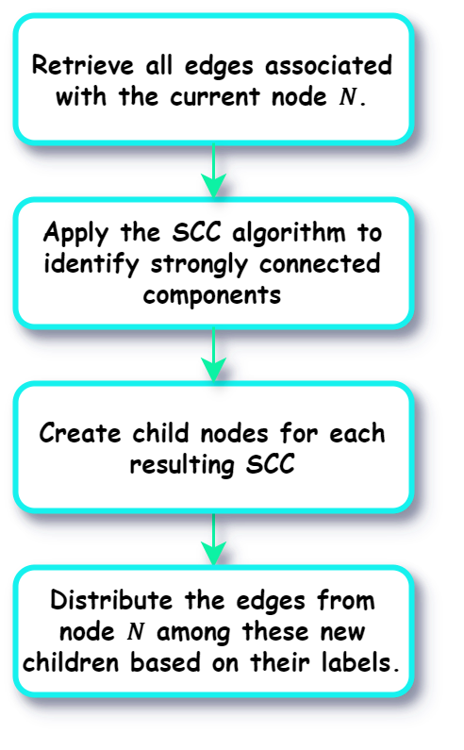
SCC Tree Creation:
In every graph G, there's a crucial master node initially containing all graph information but not induced on any specific vertex. As the SCC tree forms, this information spreads throughout the tree.
If G consists of only one vertex s, forming a graph G = ({s}, ∅), the SCC tree comprises a single node representing this vertex and the master node without any edges.
For graphs with more than one vertex, the root node of the SCC tree begins with the result of SPLIT (G, s), where s is any induced vertex selected from the current node's vertices. The root's children represent the SCCs generated from the SPLITANDCONDENSE(G, s). Each SCC produced from a vertex s and its corresponding SCC tree becomes a subtree of the root node. Instead of having separate children S_in and S_out, only one child node is added for each induced vertex S.

Slide 8
Example:
0
-1
3
-2
5
1
2
7
4
6
-2

Slide 9
Node -2:
-1
0in
-2
0out
0in
3
0
-4
0out
-3
5
-4
1
2
7
-4
-3
4
6
-3

Slide 10
Node -3:
-1
1out
-2
1in
1out
2
1in
0
-4
-3
-5
4
6
-5
1
-5

Slide 11
Node -5:
-1
-2
2out
2in
0
-4
4
-3
6
1
-5
2
4
6

Slide 12
Node -4:
-1
-2
3out
3in
0
-4
7
-3
3
7
5
1
-5
5
2
4
6

Slide 13
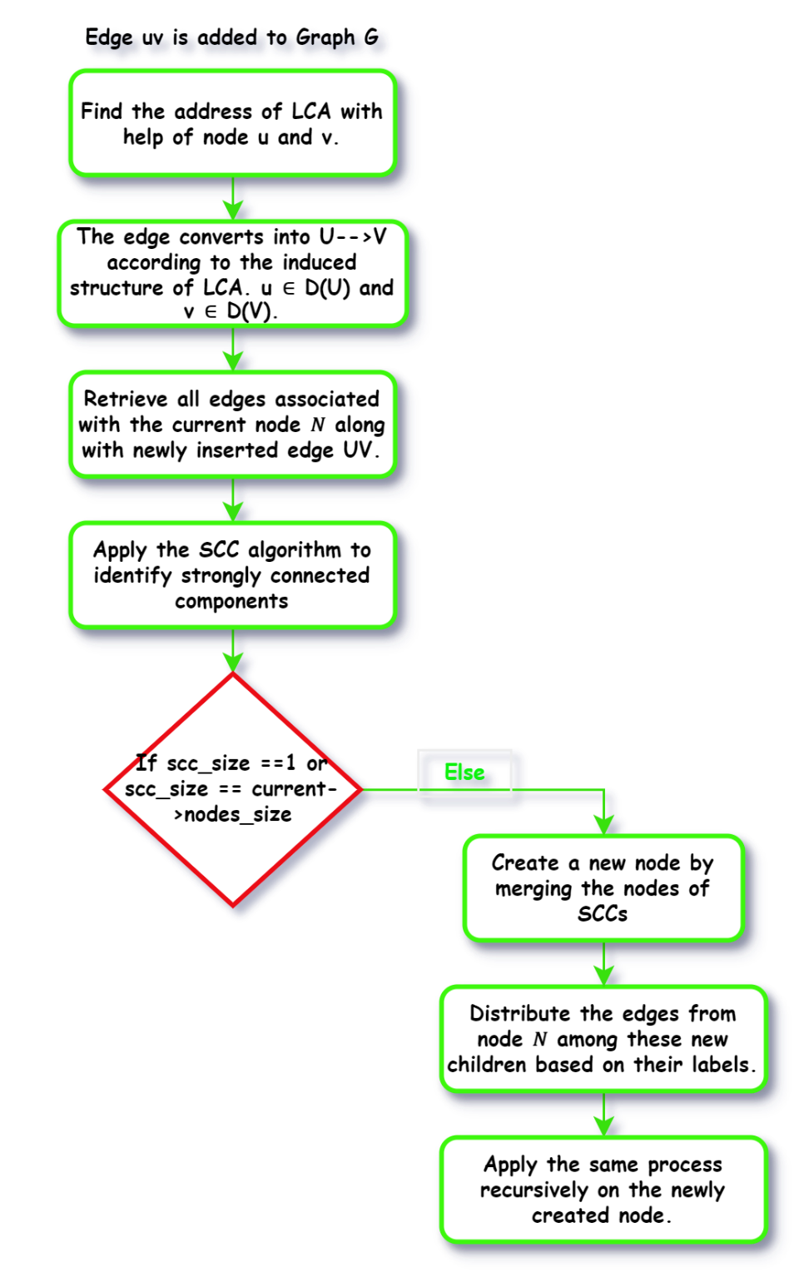
Edge Insertion and SCC Updation:
When inserting an edge uv into graph G, first find the Least Common Ancestor (LCA) of nodes u and v. Then, update the graph structure with the new edge to get a new SAC referred as X’.
Apply the Strongly Connected Components (SCC) algorithm to X’ using SPLITANDCONDENSE(X', d) to identify SCCs associated with X’.
Ignore SCCs of size 1, as they are part of the original node N. For SCCs with more than one node, if their size is not equal to the number of nodes in node N, create a new node and append the nodes from these SCCs as children. Distribute the edges from node N among the newly created children based on their labels. Skip this step if no new children are created.
Applying the approach recursively till no new children are created.

Slide 14
Example:
-1
0
-2
1
2
0
1
2
-3
3
3
4
5
4
5

Slide 15
Node -2:
-1
0in
0out
-2
0in
0out
0
-4
1
2
1
2
-3
-4
-3
3
4
5
1
2
-3
-4
3
4
5

Slide 16
Node -4:
-1
-2
1in
1out
0
-4
-3
2
1
2
-3
3
4
5

Slide 17
Unreachability(G):
Unreachability on Node N
Reachability refers to the list of nodes that can be reached from a specific node. In other words, vertex V is considered reachable from vertex U if there is a path from U to V.
Here, we define reachability somewhat differently from the conventional approach, as we are working with a graph structures that has a single source and sink. Given this structure, we define reachability as the nodes that lie along any path from the source to the sink.
Thus, a node is considered reachable if it exists on any of the paths between the source and the sink. Vertices that are not reachable are classified as unreachable nodes.
Unreachable
Nodes are
{F,G}
SI
SO
D
C
E
F
G

Slide 18
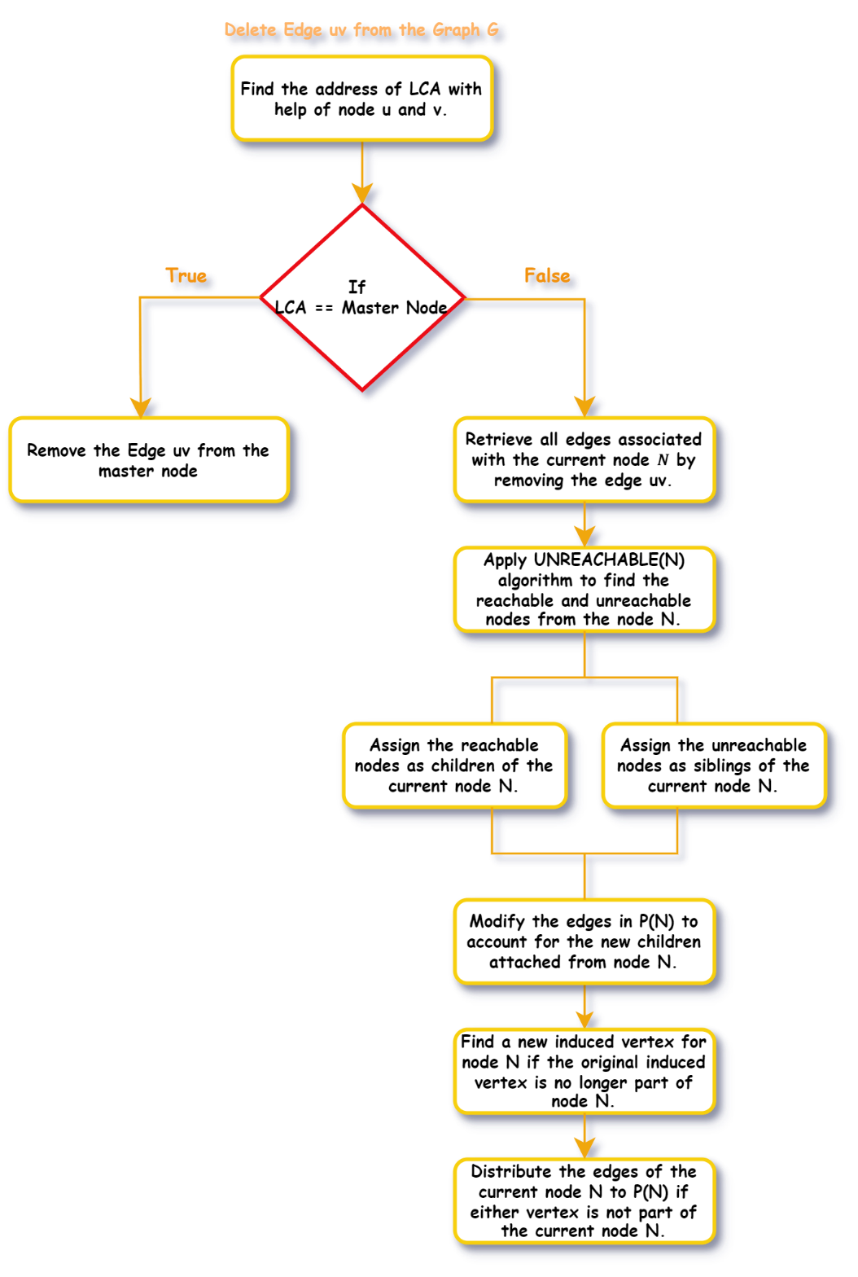
Edge Deletion and SCC Updation:
When deleting an edge uv from graph G, find the Least Common Ancestor (LCA) of nodes u and v.
Simply remove the edge from the SAC(LCA). Then, invoke the UNREACHABLE(LCA) operation, which generates two lists: Rn​ containing nodes reachable from node LCA, and Un​ containing unreachable nodes from node LCA.
Unreachable nodes, not part of the current SCC, are designated as siblings of LCA, while reachable nodes remain within LCA. If LCA is the root node R of an SCC tree, any unreachable nodes form a new SCC tree outside the current one.
Following this, redistribute edges between the parent node P(N) and N. Edges between the nodes of N are retained, while those don’t are moved to P(N), based on the reachable nodes in N.
Repeat the process upwards towards the root until reaching the root of the current SCC tree.

Slide 19
Example:
-1
0
-2
3
0
-4
-3
1
5
2
7
3
7
1
-5
5
4
6
2
4
6

Slide 20
-1
Node -5:
-2
2out
2in
0
-4
4
-3
6
3
7
1
-5
5
2
Unreachable
Nodes are
{2,4,6}
4
6
2
4
6

Slide 21
Node -3:
-1
1in
1out
-2
0
-4
4
2
-3
1
6
2
6
3
7
1
4
5
Unreachable
Nodes are
{1,2,4,6}
2
4
6

Slide 22
Node -2:
-1
0in
0out
-2
4
6
0
-4
-4
2
1
1
6
2
4
3
7
6
4
5
Unreachable
Nodes are
{4,6}

Slide 23
Challenges Faced:
Creation of SCC Tress in Parallel:
Allocating memory directly within kernel functions poses challenges due to potential performance issues such as warp divergence. While cudaMalloc can be used, accessing allocated memory immediately after creation can lead to complications. Alternatively, using malloc() or new within kernel functions is possible but may increase execution time due to warp divergence. A more efficient approach involves pre-allocating memory on the host using cudaMalloc and passing it to the kernel via host-side loops.
Working on large graphs:
When dealing with large graphs, creating trees with considerable height can significantly increase the time required to construct the SCC (Strongly Connected Components) tree. To mitigate this, it's essential to set a maximum depth limit for the SCC tree. Thus, imposing a height limit results in increased processing time for both the incremental and decremental aspects.

Slide 24
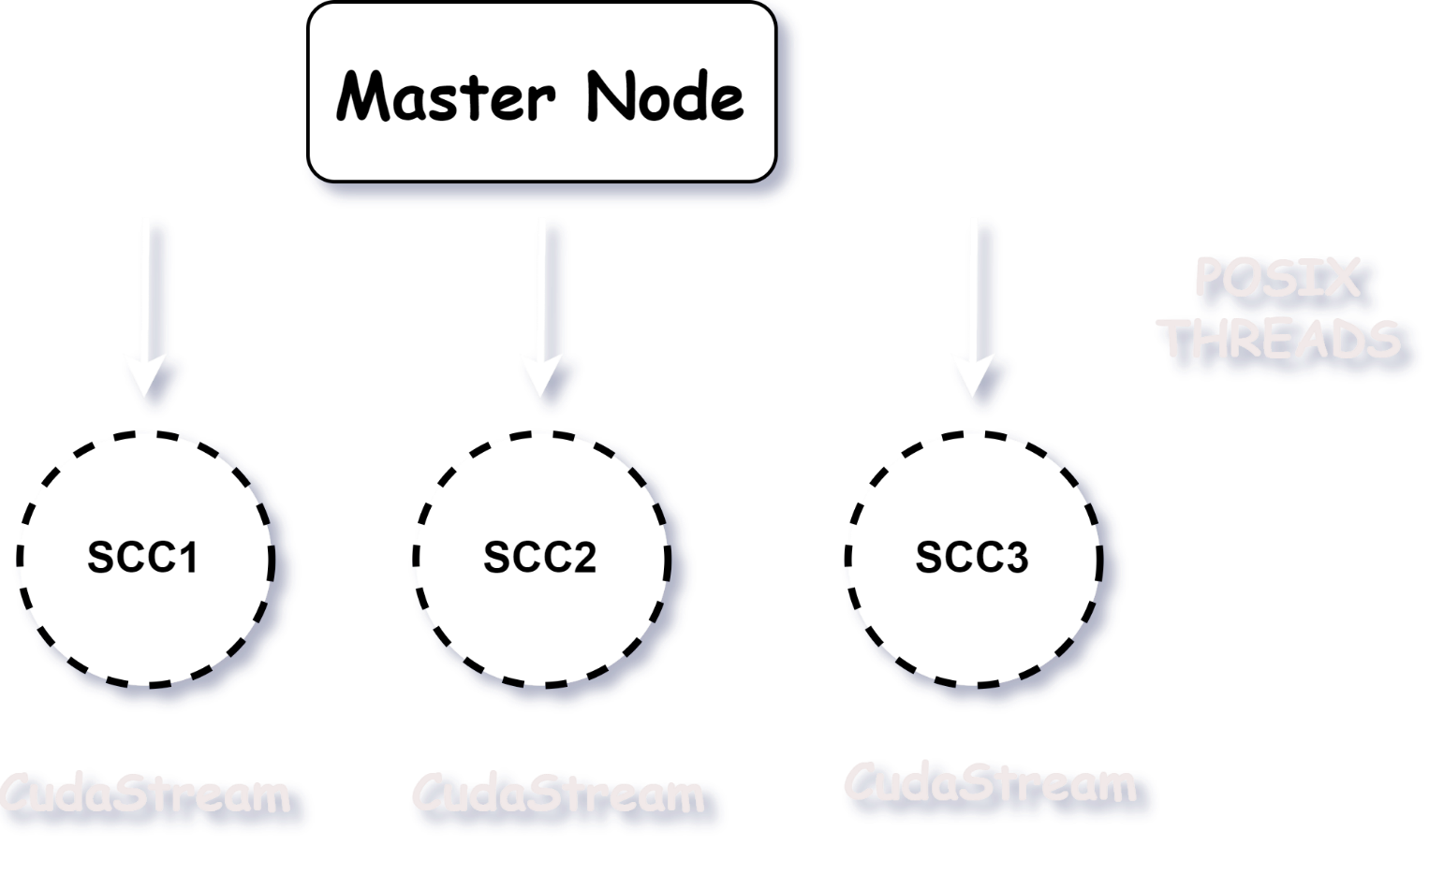
Idea to implement SCC Trees in Parallel:
Assign each POSIX thread to each SCC in the graph and create a cudaStream to each thread so that the kernel launches gets pushed in the cudastream associated with the particular thread

Slide 25
Thank you
Sai Siddarth
CS20B059

